Slide 1
Parallel DBMS

Slide 2
Introduction
Some times the client server & Centralized System is not much efficient to handle huge amount of data with high data transfer rate.
Companies need to handle huge amount of data with high data transfer rate. The client server and centralized system is not much efficient.
The need to improve the efficiency gave birth to the concept of parallel databases.
Parallel database system improves performance of data processing using multiple resources in parallel like multiple CPU and disk used parallely.
It also performs many parallelization operations like data loading and query processing.

Slide 3
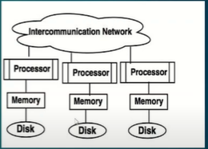

Slide 4
Goals
Improve performance
Improve availability of data
Improve Reliability
Provide distributed access of data

Slide 5
Parameters for parallel Databases
Some parameters to judge the performance of parallel databases are
Response Time: it is the time taken too complete a single task for given time
Speed up in parallel database: Speed up is the process of increasing degree of (resources) parallelism to complete a running task in less time.
The time required for running task is inversely proportional to number of resources.
Speed up = time1/timen

Slide 6
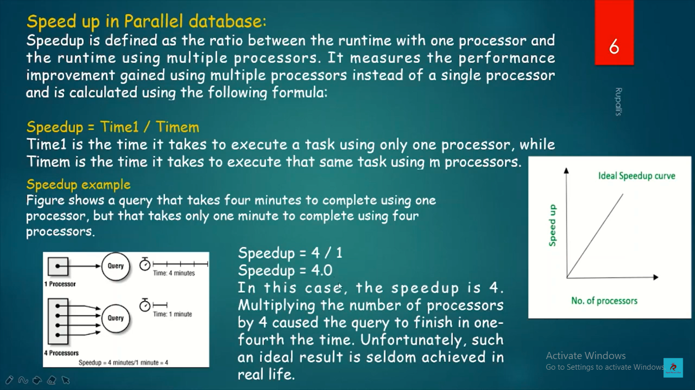

Slide 7
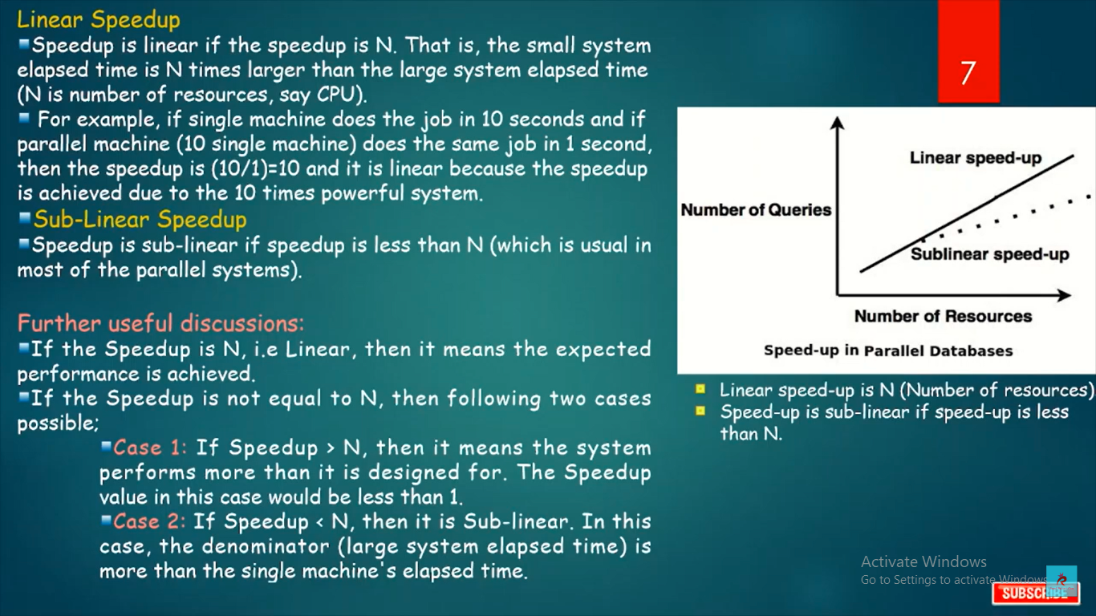

Slide 8
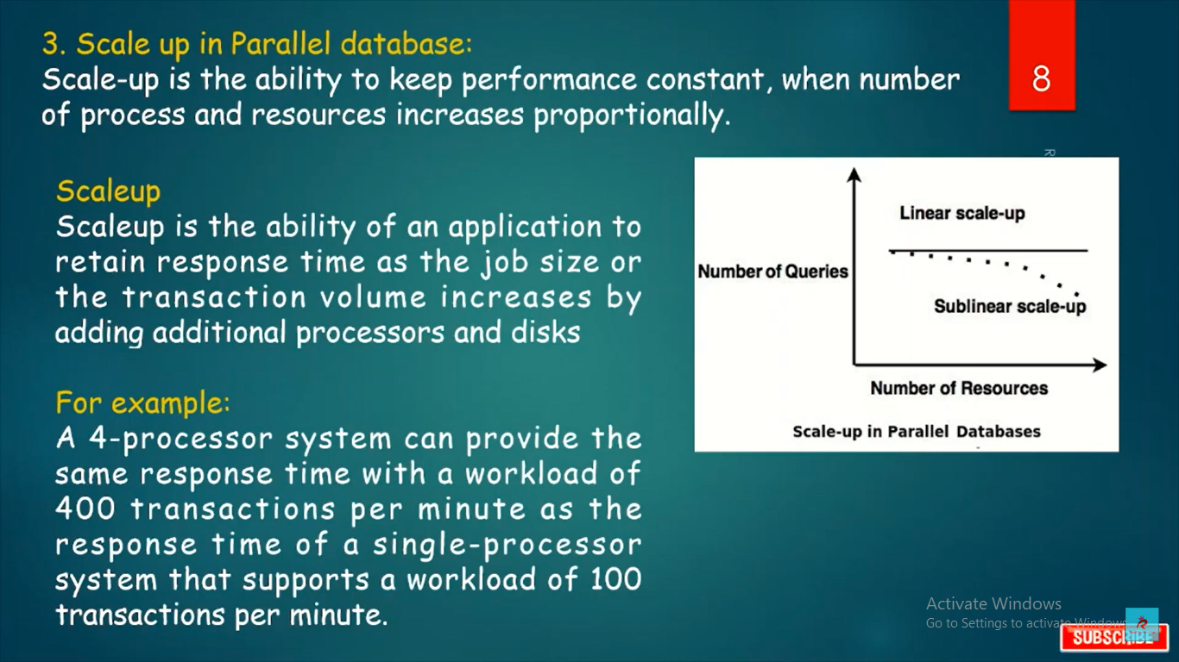

Slide 9
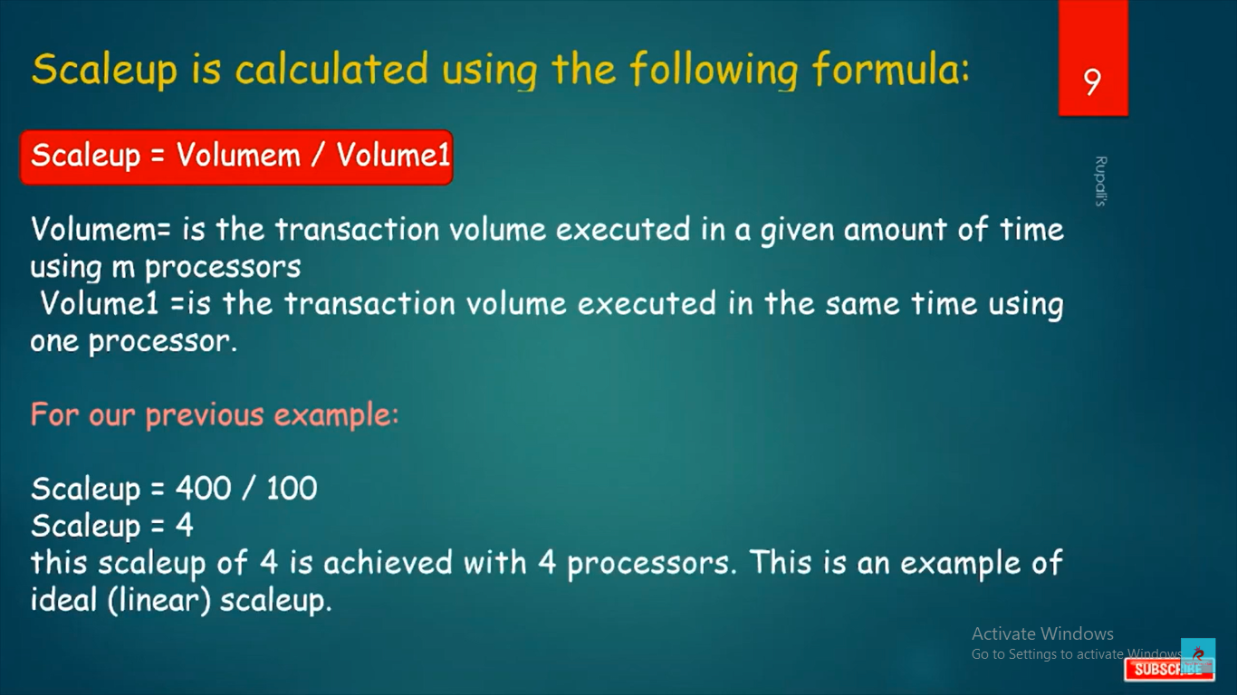

Slide 10
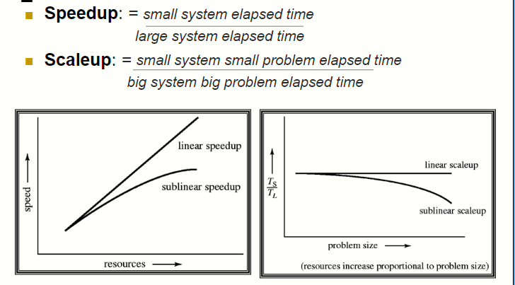

Slide 11
Parallel Database Architecture
Types of parallel Database Architecture
Shared Memory System
Shared Disk System
Shared nothing disk system

Slide 12
Shared memory system
Shared memory system uses multiple processors which is attached to a global shared memory via intercommunication channel or communication bus.
Shared memory system have large amount of cache memory at each processors, so referencing of the shared memory is avoided
If a processor performs a write operation to memory location, the data should be updated or removed from that location.

Slide 13
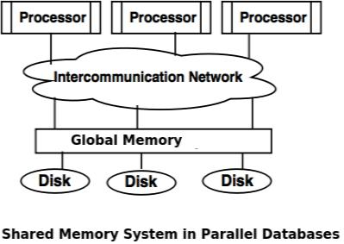

Slide 14
Advantages of Shared memory systemData is easily accessible to any processor.
One processor can send message to other efficiently.
Disadvantages of Shared memory system
Waiting time of processors is increased due to more number of processors.
Bandwidth problem.

Slide 15
Shared disk system
Shared disk system uses multiple processors which are accessible to multiple disks via intercommunication channel and every processor has local memory.
Each processor has its own memory so the data sharing is efficient.
The system built around this system are called as clusters.

Slide 16
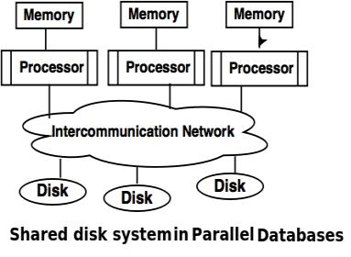

Slide 17
Advantages of Shared Disk System
Fault tolerance is achieved using shared disk system. Fault tolerance: If a processor or its memory fails, the other processor can complete the task. This is called as fault tolerance.
Disadvantage of Shared Disk System
Shared disk system has limited scalability as large amount of data travels through the interconnection channel.
If more processors are added the existing processors are slowed down.

Slide 18
Shared nothing disk system
Each processor in the shared nothing system has its own local memory and local disk.
Processors can communicate with each other through intercommunication channel.
Any processor can act as a server to serve the data which is stored on local disk.

Slide 19
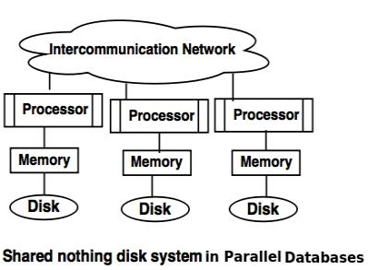

Slide 20
Advantages of Shared nothing disk system
Number of processors and disk can be connected as per the requirement in share nothing disk system.
Shared nothing disk system can support for many processor, which makes the system more scalable.
Disadvantages of Shared nothing disk system
Data partitioning is required in shared nothing disk system.
Cost of communication for accessing local disk is much higher.

Slide 21
Parallel Query Processing

Slide 22
Query Parallelism
Executing Database Query/ queries in parallel
The concept of parallelism can be exploited in executing multiple database queries in parallel.
Techniques of Query Evaluation
The two techniques used in query evaluation are as follows:
Inter query parallelism
Intra query parallelism

Slide 23
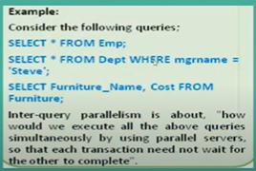
Inter query parallelism
This technique allows to run multiple queries on different processors simultaneously.
Pipelined parallelism is achieved by using inter query parallelism, which improves the output of the system.
For example: If there are 6 queries, each query will take 3 seconds for evaluation. Thus, the total time taken to complete evaluation process is 18 seconds. Inter query parallelism achieves this task only in 3 seconds. However, Inter query parallelism is difficult to achieve every time.

Slide 24

Intra query parallelism
In this technique query is divided in sub queries which can run simultaneously on different processors, this will minimize the query evaluation time.
Intra query parallelism improves the response time of the system.
If we have 6 queries, which can take 3 seconds to complete the evaluation process, the total time to complete the evaluation process is 18 seconds. But We can achieve this task in only 3 seconds by using intra query evaluation as each query is divided in sub-queries.

Slide 25
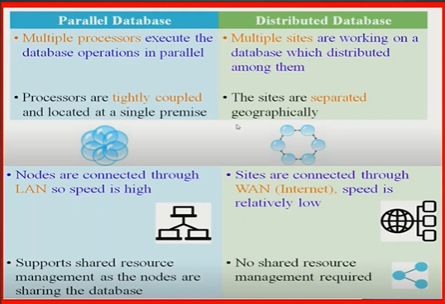

Slide 26
